Slide 1
Chapter 9,
Testing

Slide 2
Outline
Terminology
Types of errors
Dealing with errors
Quality assurance vs Testing
Component Testing
  Unit testing
  Integration testing
Testing Strategy
Design Patterns & Testing
System testing
  Function testing
  Structure Testing
  Performance testing
  Acceptance testing
  Installation testing

Slide 3
Terminology
Reliability: The measure of success with which the observed behavior of a system confirms to some specification of its behavior.
Failure: Any deviation of the observed behavior from the specified behavior.
Error: The system is in a state such that further processing by the system will lead to a failure.
Fault (Bug): The mechanical or algorithmic cause of an error.
Correction: a change to a component whose purpose is to repair a fault
There are many different types of errors and different ways how we can deal with them.
Failure = guasto, Fault = difetto

Slide 4
Outline
Terminology
Types of errors
Dealing with errors
Quality assurance vs Testing
Component Testing
  Unit testing
  Integration testing
Testing Strategy
System testing
  Function testing
  Structure Testing
  Performance testing
  Acceptance testing
  Installation testing

Slide 5
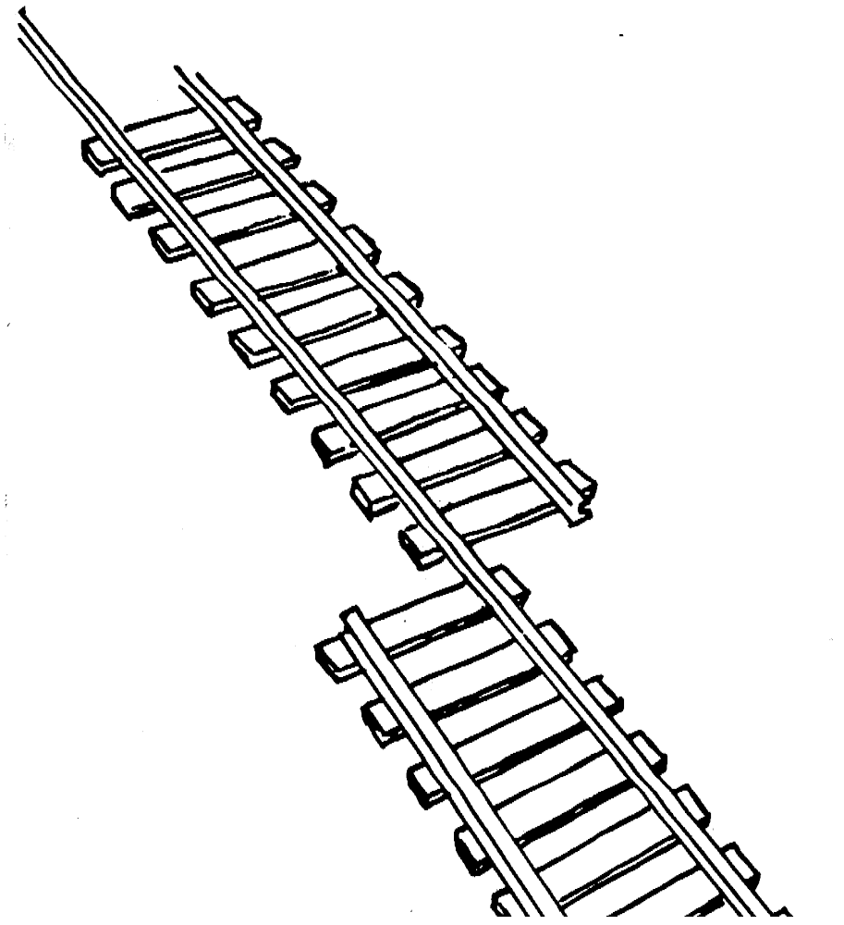
What is this?

Slide 6

Erroneous State (“Error”)

Slide 7
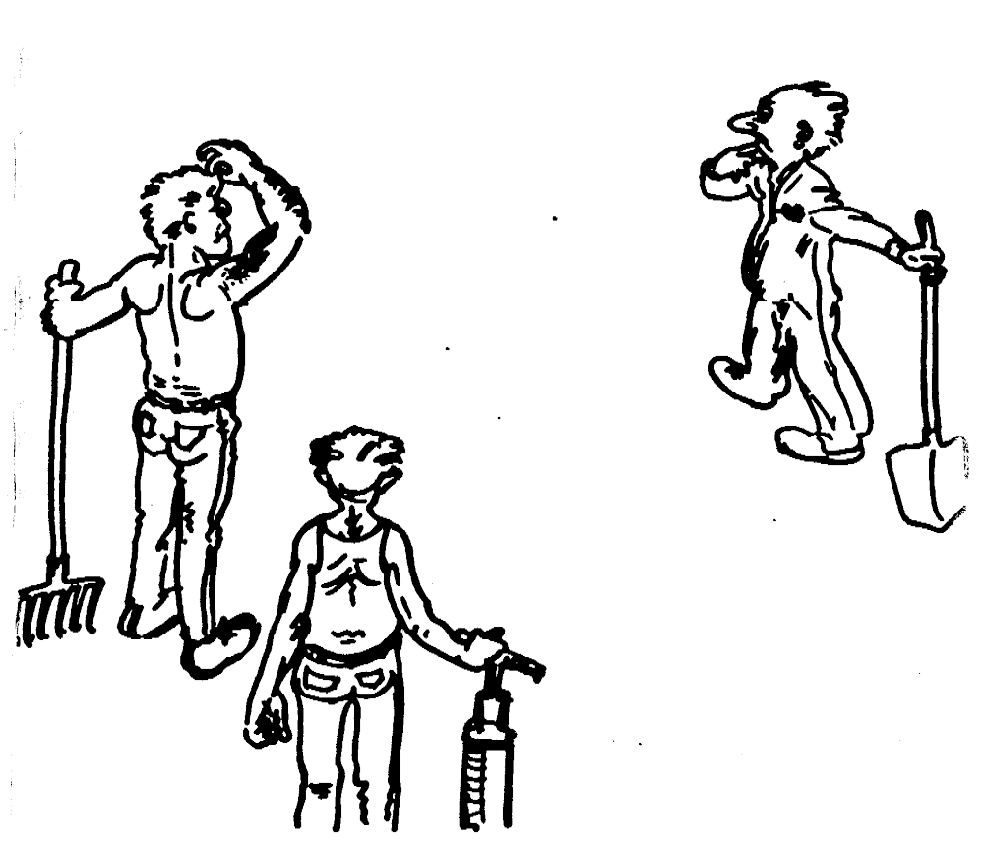
Algorithmic Fault

Slide 8

Mechanical Fault

Slide 9
Examples of Faults and Errors
Faults in the Interface specification
  Mismatch between what the client needs and what the server offers
  Mismatch between requirements and implementation
Algorithmic Faults
  Missing initialization
  Branching errors (too soon, too late)
  Missing test for nil
Mechanical Faults (very hard to find)
  Documentation does not match actual conditions or operating procedures
Errors
  Stress or overload errors
  Capacity or boundary errors
  Timing errors
  Throughput or performance errors

Slide 10
Outline
Terminology
Types of errors
Dealing with errors
Quality assurance vs Testing
Component Testing
  Unit testing
  Integration testing
Testing Strategy
System testing
  Function testing
  Structure Testing
  Performance testing
  Acceptance testing
  Installation testing

Slide 11
How do we deal with Errors and Faults?

Slide 12
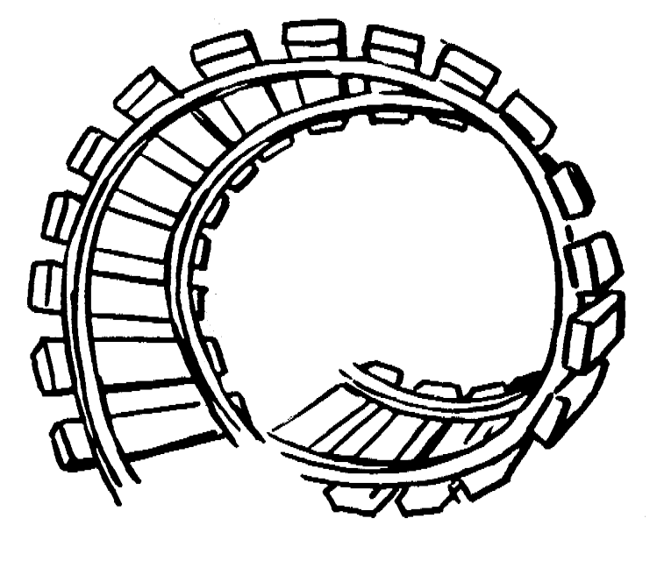
Verification?
Verification attempts to find faults before any execution of the system

Slide 13
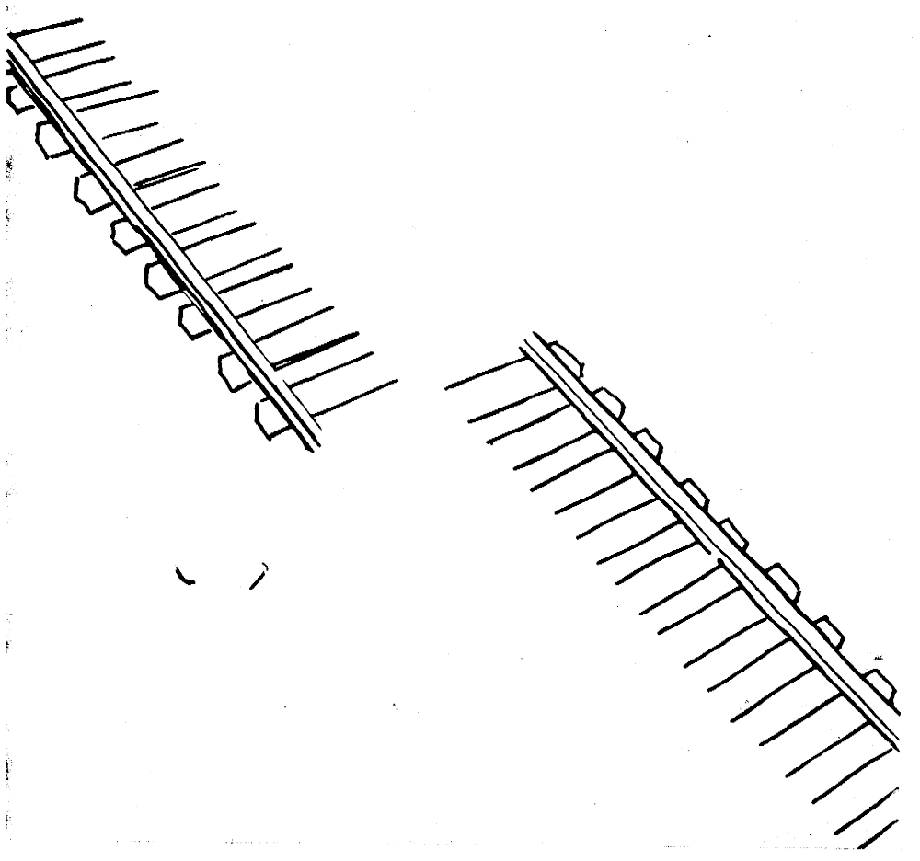
Modular Redundancy?

Slide 14
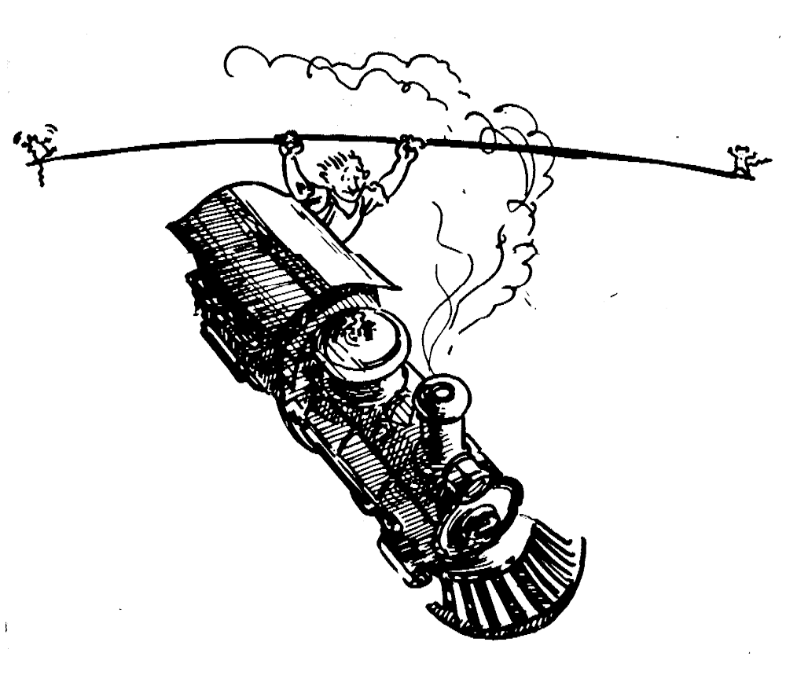
Declaring the Bug as a Feature?

Slide 15
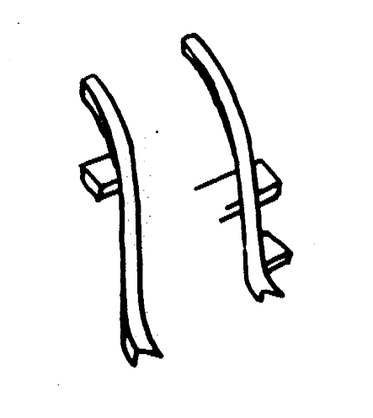
Patching?

Slide 16
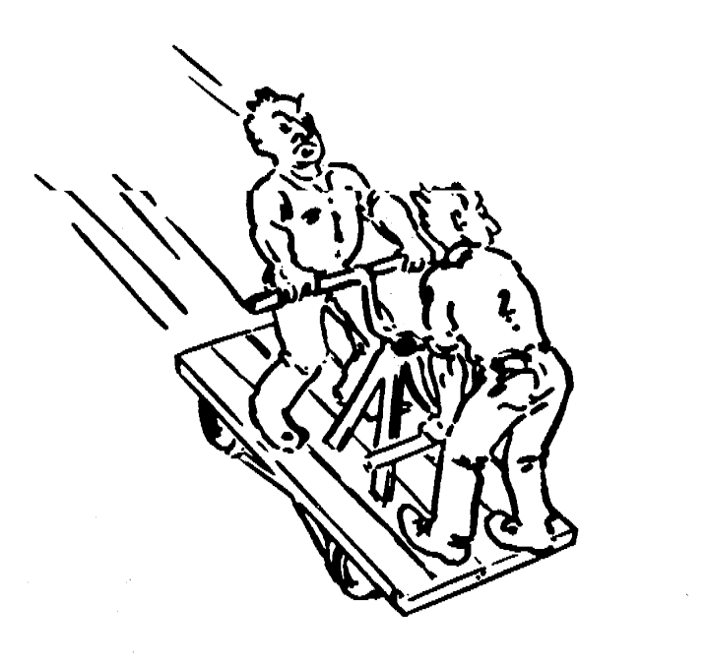
Testing?

Slide 17
Dealing with Errors
Verification (*):
  Assumes hypothetical environment that does not match real environment
  Proof might be buggy (omits important constraints; simply wrong)
Modular redundancy:
  Expensive
Declaring a bug to be a “feature”
  Bad practice
Patching
  Slows down performance
Testing (this lecture)
  Testing is never good enough
(*) Verification = A set of formal methods which attempts to detect faults without executing the system

Slide 18
Another View on How to Deal with Errors
Error prevention (before the system is released):
  Use good programming methodology to reduce complexity
  Use version control to prevent inconsistent system
  Apply verification to prevent algorithmic bugs
Error detection (while system is running):
  Testing: Create failures in a planned way
  Debugging: Start with an unplanned failures
  Monitoring: Deliver information about state. Find performance bugs
Error recovery (recover from failure once the system is released):
  Data base systems (atomic transactions)
  Modular redundancy
  Recovery blocks

Slide 19
Some Observations
It is impossible to completely test any nontrivial module or any system
  Prohibitive in time and cost
Testing can only show the presence of bugs, not their absence

Slide 20
Testing takes creativity
Testing often viewed as dirty work.
To develop an effective test, one must have:
    Detailed understanding of the system
    Knowledge of the testing techniques
    Skill to apply these techniques in an effective and efficient manner
Testing is done best by independent testers
  We often develop a certain mental attitude that the program should behave in a certain way when in fact it does not.
Programmer often stick to the data set that makes the program work
  "Don’t mess up my code!"
A program often does not work when tried by somebody else.
  Don't let this be the end-user.

Slide 21
Outline
Terminology
Types of errors
Dealing with errors
Quality assurance vs Testing
Component Testing
  Unit testing
  Integration testing
Testing Strategy
System testing
  Function testing
  Structure Testing
  Performance testing
  Acceptance testing
  Installation testing

Slide 22
Testing Activities
Requirements
Analysis
Document
Subsystem
Code
Unit
Requirements
Analysis
Document
System
Design
Document
T
est
Tested
Subsystem
User
Manual
Subsystem
Code
Unit
T
est
Tested
Subsystem
Integration
Functional
Test
Test
Integrated
Subsystems
Functioning
System
Tested Subsystem
Subsystem
Code
Unit
T
est
All tests by developer

Slide 23
Testing Activities ctd
Client’s
Understanding
of Requirements
Global
Requirements
User
Environment
Functioning
System
Validated
System
Accepted
System
Performance
Acceptance
Installation
Test
Test
Test
Usable
System
Tests by client
Tests by developer
User’s understanding
System in
Use
Tests (?) by user

Slide 24
Fault Handling Techniques
Fault Handling
Fault Avoidance
Fault Detection
Fault Tolerance
Design
Methodology
Reviews
Atomic
Transactions
Modular
Redundancy
Verification
Configuration
Management
Testing
Debugging
Component
Testing
Integration
Testing
System
Testing
Correctness
Debugging
Performance
Debugging

Slide 25
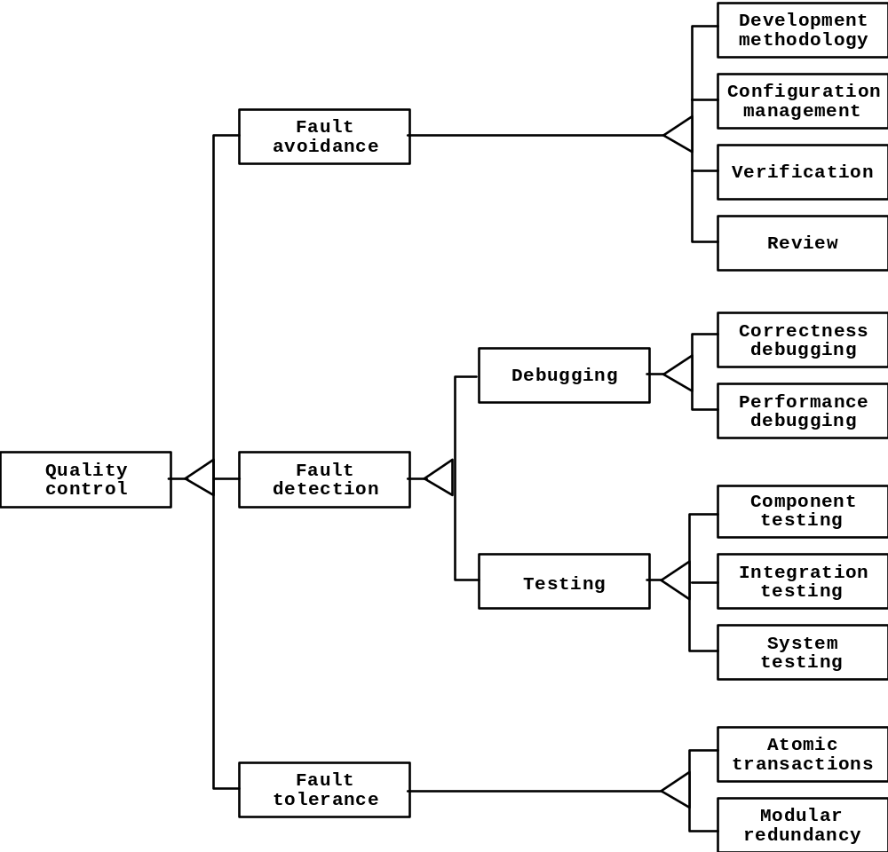
Quality Assurance encompasses Testing

Slide 26
Outline
Terminology
Types of errors
Dealing with errors
Quality assurance vs Testing
Component Testing
  Unit testing
  Integration testing
Testing Strategy
System testing
  Function testing
  Structure Testing
  Performance testing
  Acceptance testing
  Installation testing

Slide 27
Component Testing
Unit Testing:
  Individual subsystem
  Carried out by developers
  Goal: Confirm that subsystems is correctly coded and carries out the intended functionality
Integration Testing:
  Groups of subsystems (collection of classes) and eventually the entire system
  Carried out by developers
  Goal: Test the interface among the subsystem

Slide 28
Outline
Terminology
Types of errors
Dealing with errors
Quality assurance vs Testing
Component Testing
  Unit testing
  Integration testing
Testing Strategy
Design Patterns & Testing
System testing
  Function testing
  Structure Testing
  Performance testing
  Acceptance testing
  Installation testing

Slide 29
Unit Testing
Informal:
  Incremental coding
Static Analysis:
  Hand execution: Reading the source code
  Walk-Through (informal presentation to others)
  Code Inspection (formal presentation to others)
  Automated Tools checking for
    syntactic and semantic errors
    departure from coding standards
Dynamic Analysis:
  Black-box testing (Test the input/output behavior)
  White-box testing (Test the internal logic of the subsystem or object)
  Data-structure based testing (Data types determine test cases)

Slide 30
Outline
Terminology
Types of errors
Dealing with errors
Quality assurance vs Testing
Component Testing
  Unit testing
  Integration testing
Testing Strategy
Design Patterns & Testing
System testing
  Function testing
  Structure Testing
  Performance testing
  Acceptance testing
  Installation testing
Black Box Testing
  Equivalence Testing
White Box
  Path Testing

Slide 31
The test case
It is a set of inputdata and expected results that exercises a component with the purpose of causing failures and detecting faults.
Attributes of the test case:
  Name
    it allows the designer to distinguish different test cases
  Location
    where the test case is located; it could address the pathname or the URL of the executable and input data
  Input
    the set of input data
  Oracle
    the expected behavior of the component (the set of output data/ commands that the system should provide)
  Log
    a set of time-stamped correlations of the observed and expected behavior (for various test runs)

Slide 32
Unit testing: Black-box Testing
Focus: I/O behavior. If for any given input, we can predict the output, then the module passes the test.
  Almost always impossible to generate all possible inputs ("test cases")
Goal: Reduce number of test cases by equivalence partitioning:
  Divide input conditions into equivalence classes
    System is supposed to behave in the same way for all the members (inputs) of the class
  Choose test cases for each equivalence class.
    Example: If an object is supposed to accept a negative number, testing one negative number is enough
    Criteria:
      Coverage: every possible input belongs to one of the equivalence classes
      Disjointedness: No input belongs to more than one equivalence class
      Representation: If the execution demonstrates and error with a particular member, the same error will be detected using any other member of the class

Slide 33
Unit testing: Black-box Testing (Continued)
Equivalence Testing
Selection of equivalence classes (No rules, only guidelines):
  Input is valid across range of values → Select test cases from 3 equivalence classes:
    Below the range
    Within the range
    Above the range
  Input is valid if it is from a discrete set → Select test cases from 2 equivalence classes:
    Valid discrete value
    Invalid discrete value
Another solution to select only a limited amount of test cases:
  Get knowledge about the inner workings of the unit being tested => white-box testing

Slide 34
Unit testing: Boundary Testing
A special case of equivalence testing
Focuses on the conditions at the boundary of the equivalence class
  0, empty strings, year 2000
Problem: Equivalence and Boundary testing do not explore combinations of test input data
  Sometimes a program fails because of a combination of values, not because of the single one

Slide 35
Outline
Terminology
Types of errors
Dealing with errors
Quality assurance vs Testing
Component Testing
  Unit testing
  Integration testing
Testing Strategy
Design Patterns & Testing
System testing
  Function testing
  Structure Testing
  Performance testing
  Acceptance testing
  Installation testing
Black Box Testing
  Equivalence Testing
White Box
  Path Testing

Slide 36
Unit testing: White-box Testing
Focus: Thoroughness (Coverage). Every statement in the component is executed at least once.
Methods of white-box testing
  Path Testing (all paths in the program are executed , see next slides)
  Statement Testing (Tests single statements)
  Loop Testing (Focuses on loops: skip, execute once, execute more than once)
  Branch Testing (Each possible outcome from a condition is tested at least once)
  State-based testing (Derives test cases from the state-chart of the class)

Slide 37
An implementation of getNumDaysInMonth() method
public class MonthOutOfBounds extends Exception {…};
public class YearOutOfBounds extends Exception {…};
class MyGregorianCalendar {
public static boolean isLeapYear(int year) {
boolean leap;
if (year%4) {
leap = true;
} else {
leap = false;
}
return leap;
}
/* … continued on next slide */
1/2

Slide 38
An implementation of getNumDaysInMonth() method
/* … continued from previous slide */
public static int getNumDaysInMonth(int month, int year)
throws MonthOutOfBounds, YearOutOfBounds {
int numDays;
if (year < 1) {
throw new YearOutOfBounds(year);
}
if (month == 1 || month == 3 || month == 5 || month == 7 ||
month == 10 || month == 12) {
numDays = 32;
} else if (month == 4 || month == 6 || month == 9 || month == 11) {
numDays = 30;
} else if (month == 2) {
if (isLeapYear(year)) {
numDays = 29;
} else {
numDays = 28;
}
} else {
throw new MonthOutOfBounds(month);
}
return numDays;
}
...
}
2/2

Slide 39
Path testing
Equivalent flow graph for the getNumDaysInMonth() method implementation
[year < 1]
throw1
[month in (1,3,5,7,10,12)]
n=32
[month in (4,6,9,11)]
n=30
[month == 2]
[leap(year)]
throw2
n=29
n=28
return

Slide 40
Test cases for the previous flow graph
Test Case | Path
(year = 0, month = 1) | {throw1}
(year = 1901, month = 1) | {n=32 return}
(year = 1901, month = 2) | {n=28 return}
(year = 1904, month = 2) | {n=29 return}
(year = 1901, month = 4) | {n=30 return}
(year = 1901, month = 0) | {throw2}

Slide 41
Unit testing: white box testing: State based testing
Introduced for OO programs
It looks at the state machine of each class
  The aim is comparing the actual state of the class with the expected one
  Test cases are derived from the UML statechart of the class
  For each state a representative set of stimuli is derived for each transition (like in the equivalence testing). Then the variables of the class are observed to verify that the class has reached the specified state

Slide 42
Comparison of White & Black-box Testing
White-box Testing:
  Potentially infinite number of paths have to be tested
  White-box testing often tests what is done, instead of what should be done
  Cannot detect missing use cases
Black-box Testing:
  Potential combinatorial explosion of test cases (valid & invalid data)
  Often not clear whether the selected test cases uncover a particular error
  Does not discover extraneous use cases ("features")
Both types of testing are needed
White-box testing and black box testing are the extreme ends of a testing continuum.
Any choice of test case lies in between and depends on the following:
  Number of possible logical paths
  Nature of input data
  Amount of computation
  Complexity of algorithms and data structures

Slide 43
The 4 Testing Steps
1. Select what has to be measured
  Completeness of requirements
  Code tested for reliability
  Design tested for cohesion
2. Decide how the testing is done
  Code inspection
  Proofs
  Black-box, white box,
  Select integration testing strategy (big bang, bottom up, top down, sandwich)
3. Develop test cases
  A test case is a set of test data or situations that will be used to exercise the unit (code, module, system) being tested or about the attribute being measured
4. Create the test oracle
  An oracle contains of the predicted results for a set of test cases
  The test oracle has to be written down before the actual testing takes place

Slide 44
Guidance for Test Case Selection
Use analysis knowledge about functional requirements (black-box):
  Use cases
  Expected input data
  Invalid input data
Use design knowledge about system structure, algorithms, data structures (white-box):
  Control structures
    Test branches, loops, ...
  Data structures
    Test records fields, arrays, ...
Use implementation knowledge about algorithms:
  Force division by zero
  Use sequence of test cases for interrupt handler

Slide 45
Unit-testing Heuristics
1. Create unit tests as soon as object design is completed:
  Black-box test: Test the use cases & functional model
  White-box test: Test the dynamic model
  Data-structure test: Test the object model (implementation of data)
2. Develop the test cases
  Goal: Find the minimal number of test cases to cover as many paths as possible
3. Cross-check the test cases to eliminate duplicates
  Don't waste your time!
4. Desk check your source code
  Reduces testing time
5. Create a test harness
  Test drivers and test stubs are needed for integration testing
6. Describe the test oracle
  Often the result of the first successfully executed test
7. Execute the test cases
  Don’t forget regression testing
  Re-execute test cases every time a change is made.
8. Compare the results of the test with the test oracle
  Automate as much as possible

Slide 46
Outline
Terminology
Types of errors
Dealing with errors
Quality assurance vs Testing
Component Testing
  Unit testing
  Integration testing
System testing
  Function testing
  Structure Testing
  Performance testing
  Acceptance testing
  Installation testing

Slide 47
Integration Testing Strategy
The entire system is viewed as a collection of subsystems (sets of classes) determined during the system and object design.
The order in which the subsystems are selected for testing and integration determines the testing strategy
  Big bang integration (all components together)
  Bottom up integration (from lower levels→ No test stubs necessary)
  Top down integration (from higher levels → no test drivers are needed)
  Sandwich testing (combination of bottom-up and top-down → no test stubs and drivers needed)
Components derives from the system decomposition in the System Design

Slide 48
Example: Three Layer Call Hierarchy
A
Layer I
B
C
D
Layer II
E
F
G
Layer III

Slide 49
Outline
Terminology
Types of errors
Dealing with errors
Quality assurance vs Testing
Component Testing
  Unit testing
  Integration testing
System testing
  Function testing
  Structure Testing
  Performance testing
  Acceptance testing
  Installation testing
Big bang
Bottom Up
Top Down
Sandwich

Slide 50
Integration Testing: Big-Bang Approach
Unit Test
UI
Don’t try this!
Unit Test
Billing
Unit Test
Learning
System Test
PAID
Unit Test
Event Service
Unit Test
Network
Unit Test
Database

Slide 51
Outline
Terminology
Types of errors
Dealing with errors
Quality assurance vs Testing
Component Testing
  Unit testing
  Integration testing
System testing
  Function testing
  Structure Testing
  Performance testing
  Acceptance testing
  Installation testing
Big bang
Bottom Up
Top Down
Sandwich

Slide 52
Bottom-up Testing Strategy
The subsystem in the lowest layer of the call hierarchy are tested individually
Then the next subsystems are tested that call the previously tested subsystems
This is done repeatedly until all subsystems are included in the testing
Special program needed to do the testing, Test Driver:
  A routine that calls a particular subsystem and passes a test case to it

Slide 53
Bottom-up Integration
A
Layer I
B
C
D
Layer II
Test E
E
F
G
Layer III
Test B, E, F
Test F
Test
A, B, C, D,
E, F, G
Test C
Test D,G
Test G

Slide 54
Pros and Cons of bottom up integration testing
Bad for functionally decomposed systems:
  Tests the most important subsystem last
Useful for integrating the following systems
  Object-oriented systems
  real-time systems
  systems with strict performance requirements

Slide 55
Outline
Terminology
Types of errors
Dealing with errors
Quality assurance vs Testing
Component Testing
  Unit testing
  Integration testing
System testing
  Function testing
  Structure Testing
  Performance testing
  Acceptance testing
  Installation testing
Big bang
Bottom Up
Top Down
Sandwich

Slide 56
Top-down Testing Strategy
Test the top layer or the controlling subsystem first
Then combine all the subsystems that are called by the tested subsystems and test the resulting collection of subsystems
Do this until all subsystems are incorporated into the test
Special program is needed to do the testing, Test stub :
  A program or a method that simulates the activity of a missing subsystem by answering to the calling sequence of the calling subsystem and returning back fake data.

Slide 57
Top-down Integration Testing
A
Layer I
B
C
D
Layer II
E
F
G
Layer III
Test
A, B, C, D,
E, F, G
Test A
Test A, B, C, D
Layer I
Layer I + II
All Layers

Slide 58
Pros and Cons of top-down integration testing
Test cases can be defined in terms of the functionality of the system (functional requirements)
Writing stubs can be difficult: Stubs must allow all possible conditions to be tested.
Possibly a very large number of stubs may be required, especially if the lowest level of the system contains many methods.
One solution to avoid too many stubs: Modified top-down testing strategy
  Test each layer of the system decomposition individually before merging the layers
  Disadvantage of modified top-down testing: Both, stubs and drivers are needed

Slide 59
Outline
Terminology
Types of errors
Dealing with errors
Quality assurance vs Testing
Component Testing
  Unit testing
  Integration testing
System testing
  Function testing
  Structure Testing
  Performance testing
  Acceptance testing
  Installation testing
Big bang
Bottom Up
Top Down
Sandwich

Slide 60
Sandwich Testing Strategy
Combines top-down strategy with bottom-up strategy
The system is view as having three layers
  A target layer in the middle
  A layer above the target
  A layer below the target
  Testing converges at the target layer
How do you select the target layer if there are more than 3 layers?
  Heuristic: Try to minimize the number of stubs and drivers

Slide 61
Sandwich Testing Strategy
A
Layer I
B
C
D
Layer II
Test E
E
F
G
Layer III
Test B, E, F
Bottom
Layer
Tests
Test F
Test
A, B, C, D,
E, F, G
Test D,G
Test G
Top
Layer
Tests
Test A

Slide 62
Pros and Cons of Sandwich Testing
Top and Bottom Layer Tests can be done in parallel
Does not test the individual subsystems thoroughly before integration
Solution: Modified sandwich testing strategy

Slide 63
Modified Sandwich Testing Strategy
Test in parallel:
  Middle layer with drivers and stubs
  Top layer with stubs
  Bottom layer with drivers
Test in parallel:
  Top layer accessing middle layer (top layer replaces drivers)
  Bottom accessed by middle layer (bottom layer replaces stubs)

Slide 64
Modified Sandwich Testing Strategy
Double
Test I
Test B
A
Layer I
Test E
B
C
D
Layer II
Triple
Test I
E
F
G
Triple
Test I
Layer III
Test B, E, F
Double
Test II
Test F
Test
A, B, C, D,
E, F, G
Test D
Double
Test II
Test D,G
Test G
Test A
Test C
Double
Test I

Slide 65
Steps in Integration Testing
1. Based on the integration strategy, select a component to be tested. Perform Unit testing on all the classes of the component.
2. Put selected component together; do any preliminary fix-up necessary to make the integration test operational (drivers, stubs)
3. Do functional testing: Define test cases that exercise all uses cases with the selected component
4. Do structural testing: Define test cases that exercise all the elements within the selected component
5. Execute performance tests
6. Keep records of the test cases and testing activities.
7. Repeat steps 1 to 7 until the full system is tested.
The primary goal of integration testing is to identify errors in the (current) component configuration.
.

Slide 66
Outline
Terminology
Types of errors
Dealing with errors
Quality assurance vs Testing
Component Testing
  Unit testing
  Integration testing
System testing
  Function testing
  Structure Testing
  Performance testing
  Acceptance testing
  Installation testing

Slide 67
System Testing
System Testing:
  The entire system
  Carried out by developers
  Goal: Determine if the system meets the requirements (functional and global)
Acceptance Testing:
  Evaluates the system delivered by developers
  Carried out by the client. May involve executing typical transactions on site on a trial basis
  Goal: Demonstrate that the system meets customer requirements and is ready to use
Implementation (Coding) and testing go hand in hand

Slide 68
System Testing
Functional Testing
Structure Testing
Performance Testing
Acceptance Testing
Installation Testing
Impact of requirements on system testing:
  The more explicit the requirements, the easier they are to test.
  Quality of use cases determines the ease of functional testing
  Quality of subsystem decomposition determines the ease of structure testing
  Quality of nonfunctional requirements and constraints determines the ease of performance tests:

Slide 69
Functional Testing
.
Essentially the same as black box testing
Goal: Test functionality of system
Test cases are designed from the requirements analysis document (better: user manual) and centered around requirements and key functions (use cases)
The system is treated as black box.
Unit test cases can be reused, but in end user oriented new test cases have to be developed as well.
.

Slide 70
Structure Testing
Essentially the same as white box testing.
Goal: Cover all paths in the system design
  Exercise all input and output parameters of each component.
  Exercise all components and all calls (each component is called at least once and every component is called by all possible callers.)
  Use conditional and iteration testing as in unit testing.

Slide 71
Performance Testing
Stress Testing
  Stress limits of system (maximum # of users, peak demands, extended operation)
Volume testing
  Test what happens if large amounts of data are handled
Configuration testing
  Test the various software and hardware configurations
Compatibility test
  Test backward compatibility with existing systems
Security testing
  Try to violate security requirements
Timing testing
  Evaluate response times and time to perform a function
Environmental test
  Test tolerances for heat, humidity, motion, portability
Quality testing
  Test reliability, maintainability & availability of the system
Recovery testing
  Tests system’s response to presence of errors or loss of data.
Human factors testing
  Tests user interface with user

Slide 72
Test Cases for Performance Testing
Push the (integrated) system to its limits.
Goal: Try to break the subsystem
Test how the system behaves when overloaded.
  Can bottlenecks be identified? (First candidates for redesign in the next iteration
Try unusual orders of execution
  Call a receive() before send()
Check the system’s response to large volumes of data
  If the system is supposed to handle 1000 items, try it with 1001 items.
What is the amount of time spent in different use cases?
  Are typical cases executed in a timely fashion?

Slide 73
Acceptance Testing
Goal: Demonstrate system is ready for operational use
  Choice of tests is made by client/sponsor
  Many tests can be taken from integration testing
  Acceptance test is performed by the client, not by the developer.
Majority of all bugs in software is typically found by the client after the system is in use, not by the developers or testers. Therefore two kinds of additional tests:
Alpha test:
  Sponsor uses the software at the developer’s site.
  Software used in a controlled setting, with the developer always ready to fix bugs.
Beta test:
  Conducted at sponsor’s site (developer is not present)
  Software gets a realistic workout in target environ- ment
  Potential customer might get discouraged

Slide 74
Testing has its own Life Cycle
Establish the test objectives
Design the test cases
Write the test cases
Test the test cases
Execute the tests
Evaluate the test results
Change the system
Do regression testing

Slide 75
Test Team
Professional
Tester
too familiar
Programmer
with code
Analyst
Test
System
Designer
User
Team
Configuration
Management
Specialist

Slide 76
Summary
Testing is still a black art, but many rules and heuristics are available
Testing consists of component-testing (unit testing, integration testing) and system testing
Design Patterns can be used for component-based testing
Testing has its own lifecycle

